Slide 3
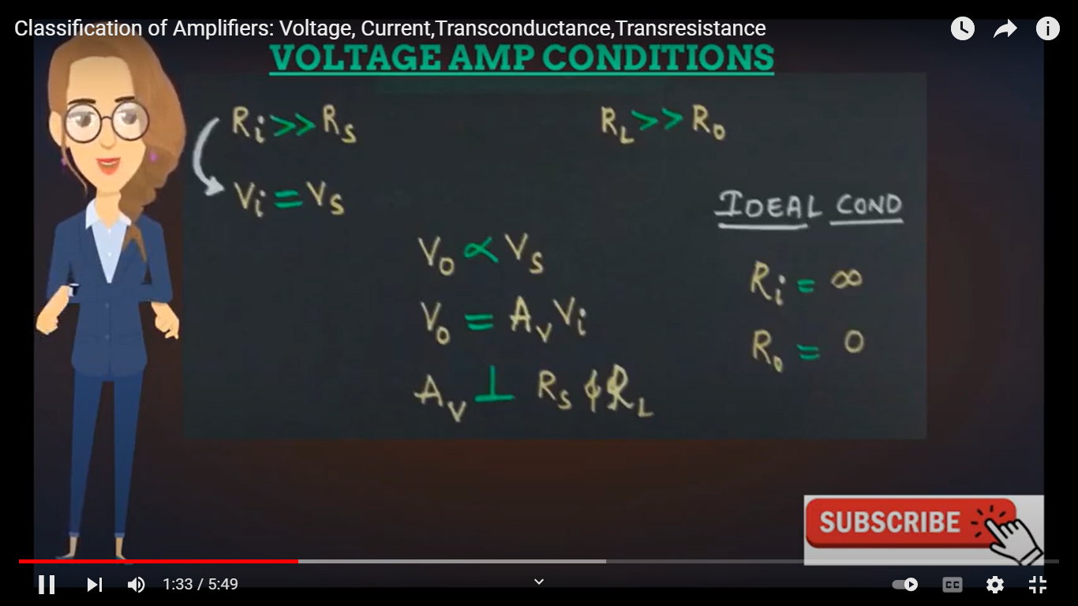
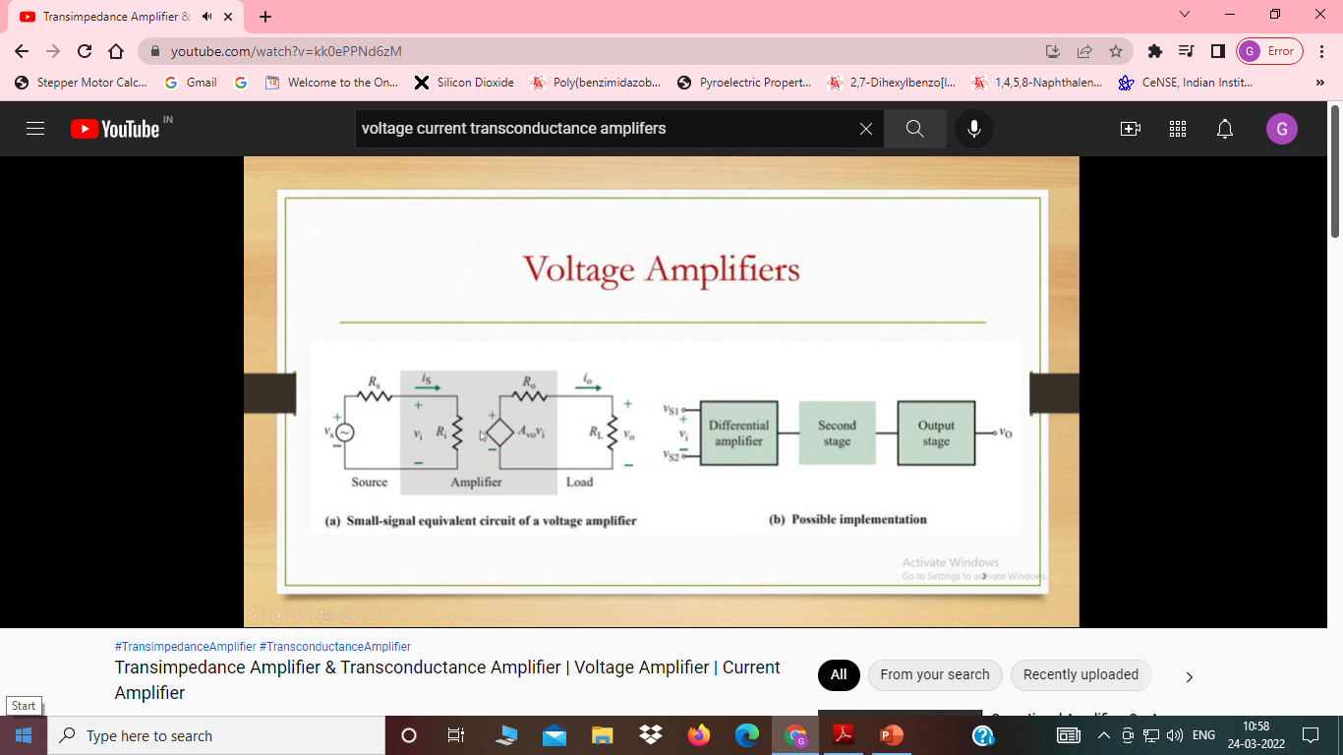

Slide 4
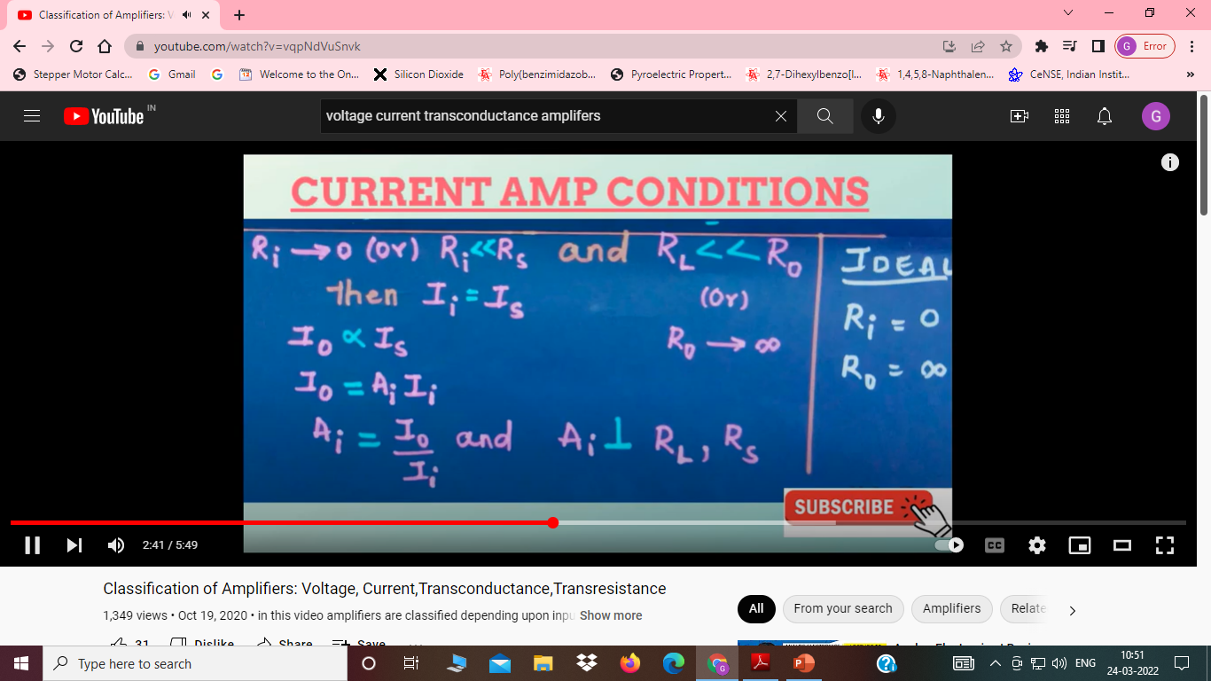
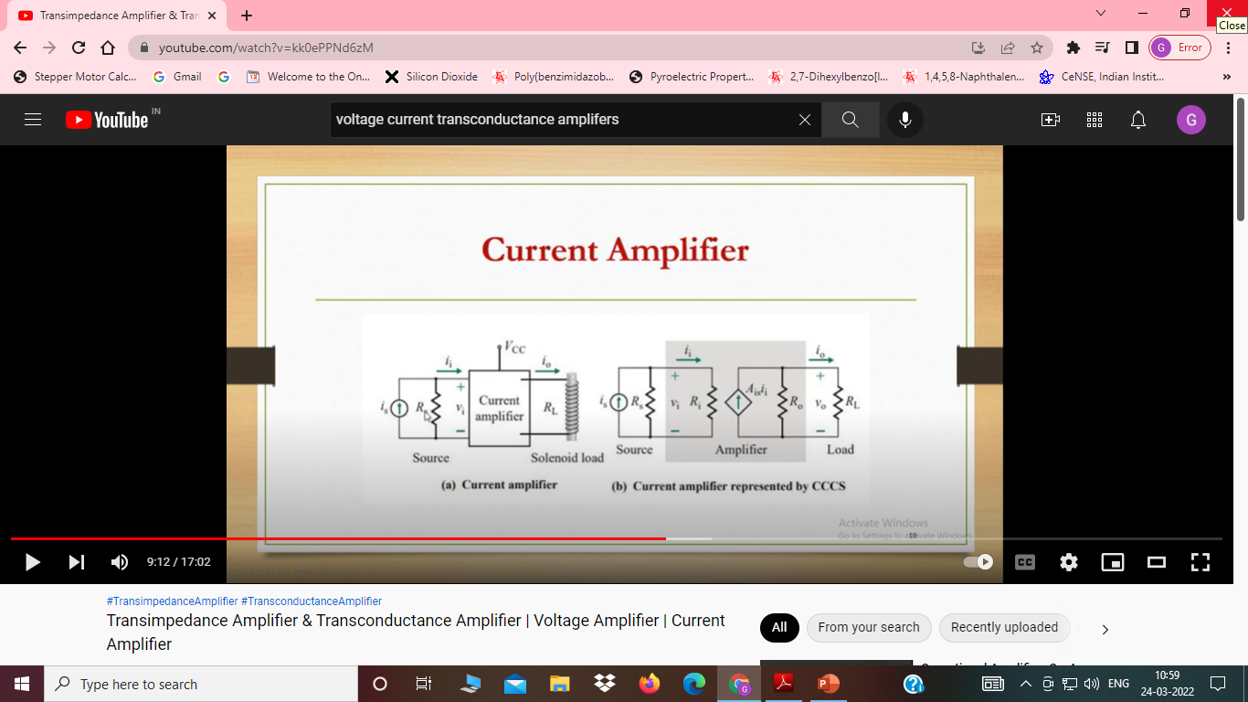

Slide 5
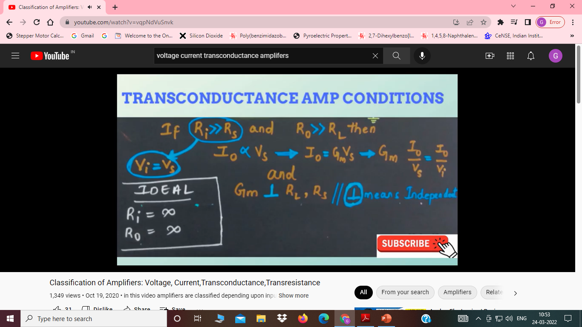
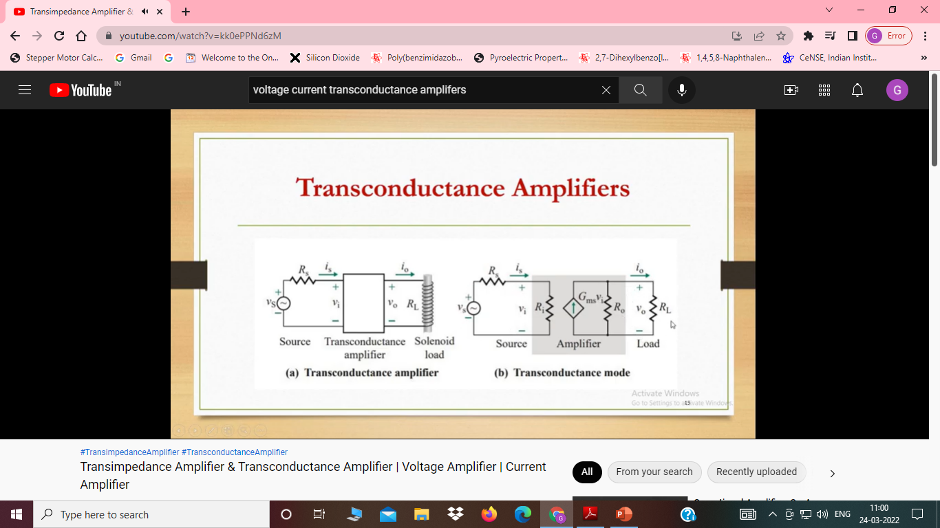

Slide 6
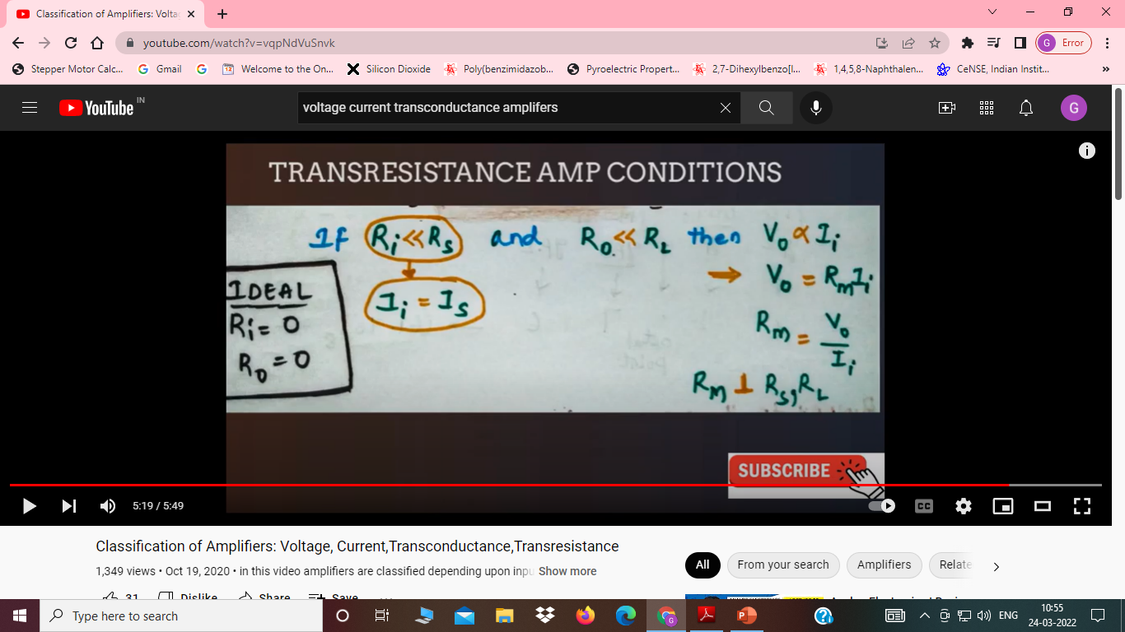
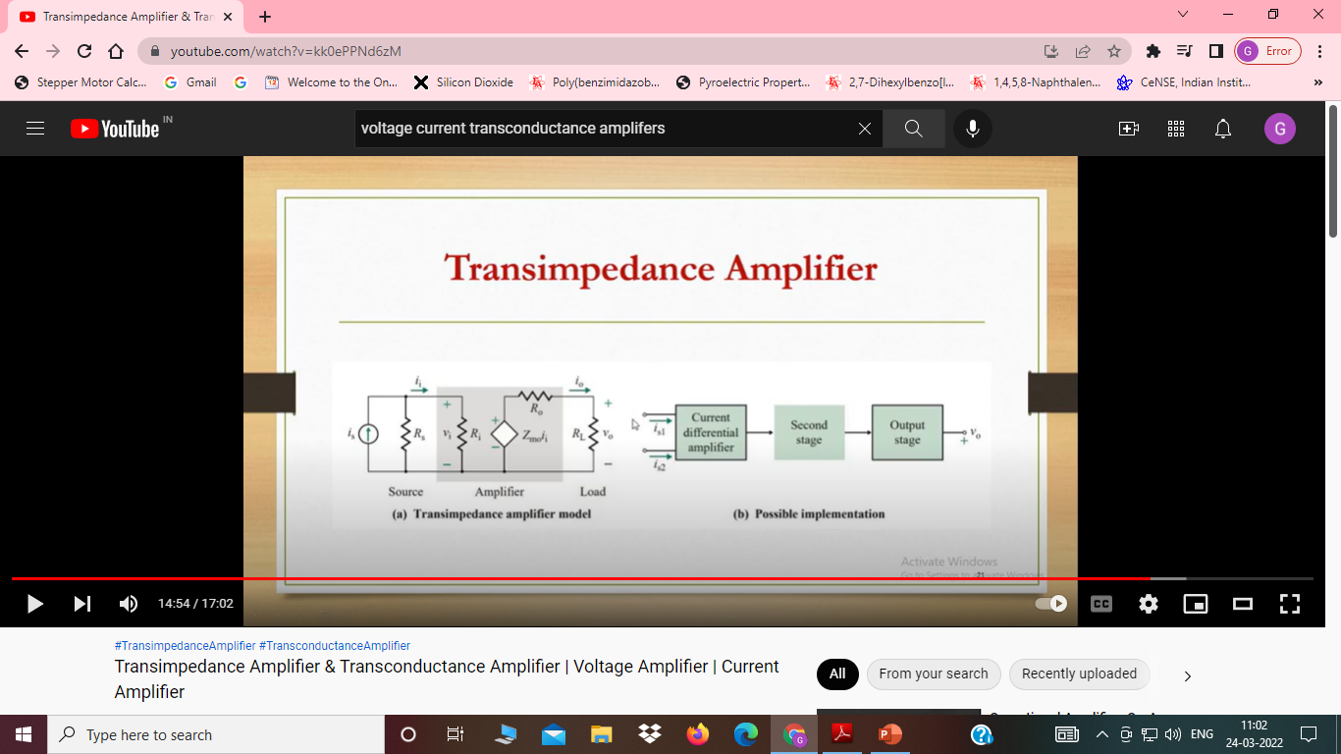

Slide 7
Feed back Amplifiers
An amplifier circuit simply increases the signal strength. But while amplifying, it just increases the strength of its input signal whether it contains information or some noise along with information.
This noise or some disturbance is introduced in the amplifiers because of their strong tendency to introduce hum due to sudden temperature changes or stray electric and magnetic fields. Therefore, every high gain amplifier tends to give noise along with signal in its output, which is very undesirable.
The noise level in the amplifier circuits can be considerably reduced by using negative feedback done by injecting a fraction of output in phase opposition to the input signal.

Slide 8
Principle of Feedback Amplifier
A feedback amplifier generally consists of two parts. They are the amplifier and the feedback circuit. The feedback circuit usually consists of resistors.
This voltage is added for positive feedback and subtracted for negative feedback, from the signal voltage Vs. Now,
Vi=Vs+Vf=Vs+βVo
Vi=Vs−Vf=Vs−βVo
The quantity β = Vf/Vo is called as feedback ratio or feedback fraction.
the gain of the amplifier is represented as A. the gain of the amplifier is the ratio of output voltage Vo to the input voltage Vi. the feedback network extracts a voltage Vf = β Vo from the output Vo of the amplifier.

Slide 15
